Slide 1


Lip Reading Using Deep Learning Algorithm

Slide 2
Team Members
S. Kavin Sundarr - 21BLC1477
Rohan Inamdar - 21BLC1311
Deepen Khandelwal - 21BLC1224
Varun Dev Sahu - 21BLC1544
Pranita Jha - 21BLC1093

Slide 3
Table of Contents
Background
Literature Survey
Problem Description
Methodology
Tools
References

Slide 4
Background
Lip reading, also known as visual speech recognition, is the process of interpreting spoken language by observing the movements of a speaker's lips. It is an important communication method, especially for individuals with hearing impairments or in situations where audio information is distorted or unavailable.
A lip reading web application can provide a user-friendly platform for real-time or recorded lip reading tasks
We have used our deep learning algorithm and trained our deep model to its max efficiency. Later we created a web application where the user can upload there pre-recorded videos and get output as text.

Slide 5
Literature Survey 1
Title of paper and Authors | Journal/Conference and Year | Concept/Approach | Limitation | Inference
Title: LIPNET: END-TO-END SENTENCE-LEVEL LIPREADING Authors: Yannis M. Assael Brendan Shillingford Shimon Whiteson Nando de Freitas | 16 Dec 2016 | Using DLib face detector to detect lips and read. Uses speech recognition model To preconceive the Data required for results. CTC’s decoder use to decode the video by frames. | Worked with limited dataset thus works only on the available data. | The proposed LipNet, the first model to apply deep learning to end-to-end learning of a model that maps sequences of image frames of a speaker’s mouth to entire sentences. The end-to-end model eliminates the need to segment videos into words before predicting a sentence.

Slide 6
Literature Survey 2
ABSTRACT:
LipNet is the first complete sentence-level lipreading model. LipNet is taught from beginning to end to provide predictions at the sentence level, just like contemporary deep learning based automatic speech recognition (ASR). Our model uses spatiotemporal convolutional neural networks (STCNNs), recurrent neural networks, and RNNs

Slide 7
Literature Survey 3
CONNECTIONIST TEMPORAL CLASSIFICATION:
Modern voice recognition heavily relies on the connectionist temporal classification (CTC) loss (Graves et al., 2006), which does away with the necessity for training data that lines up inputs and target outputs.
Suppose a model produces a the probability of a sequence is calculated by marginalising over all sequences that are defined as being equal to it. This is done using a sequence of discrete distributions over the token classes (vocabulary) supplemented with a unique "blank" token. This simultaneously removes the need for alignments and addresses variable-length sequences.

Slide 8
Literature Survey 4
Gated Recurrent Unit (GRU)
It is a type of recurrent neural network (RNN) that improves upon earlier RNNs by adding cells and gates for propagating information over more timesteps and learning to control this information flow

Slide 9
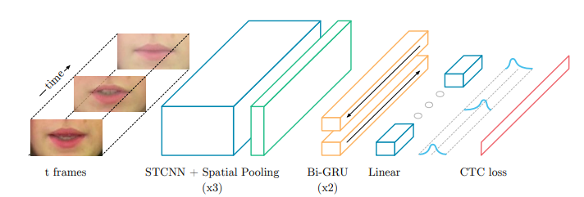
Literature Survey 5
A sequence of T frames is used as input, and is processed by 3 layers of STCNN, each followed by a spatial max-pooling layer. The features extracted are processed by 2 Bi-GRUs; each time-step of the GRU output is processed by a linear layer and a softmax. This end-to-end model is trained with CTC.

Slide 10
Literature Survey 6
LIPNET ARCHITECTURE
LipNet architecture, which starts with 3×(spatiotemporal convolutions, channel-wise dropout, spatial max-pooling). Subsequently, the features extracted are followed by two Bi-GRUs. The Bi-GRUs are crucial for efficient further aggregation of the STCNN output. Finally, a linear transformation is applied at each time-step, followed by a softmax over the vocabulary augmented with the CTC blank, and then the CTC loss. A

Slide 11
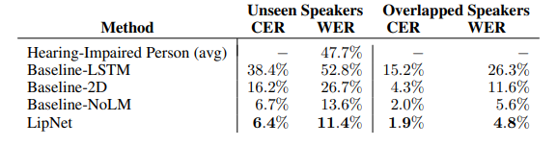
Literature Survey 7
Computing the word error rate (WER) and the character error rate (CER), standard metrics for the performance of ASR models.
We find the least errors in the LipNet model
LipNet exhibits a 2.3× higher performance in the overlapped compared to the unseen speakers split.
Baseline-2D and LipNet achieve 1.8× and 4.2× lower WER, respectively, than hearing-impaired people.

Slide 12
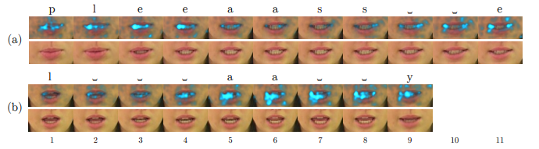
Literature Survey 8
applying saliency visualisation techniques to interpret LipNet’s learned behaviour, showing that the model attends to phonologically important regions in the video. In particular, in Figure a and b we analyse two saliency visualisations for the words 'please' and 'lay' frame by frame.

Slide 13
Literature Survey 9
Saliency maps for the words (a) please and (b) lay, produced by backpropagation to the input, showing the places where LipNet has learned to attend. The pictured transcription is given by greedy CTC decoding. CTC blanks are denoted by ‘ ␣ ’.

Slide 14
Literature Survey 10
IMPLEMENTATION:
LipNet is implemented using Torch, the warp-ctc CTC library (Amodei et al., 2015), and StanfordCTC’s decoder implementation. The network parameters were initialised, apart from the square GRU matrices that were orthogonally initialised. The models were trained with channel-wise dropout (dropout rate p = 0.5) after each pooling layer and mini-batches of size 50.
The CER and WER scores were computed using CTC beam search with the following parameters for Stanford-CTC’s decoder: beam width 200, α = 1, and β = 1.5.

Slide 15
Problem Description
Create a Lip Reading Web Application Using Lip Reading deep Learning Algorithm.
The project-
https://drive.google.com/drive/folders/1e4yLoQbmnmEangpw-l6aAOxWpS61fEGc?usp=sharing
https://github.com/KavinSundarr/LipReading-Webapp

Slide 16
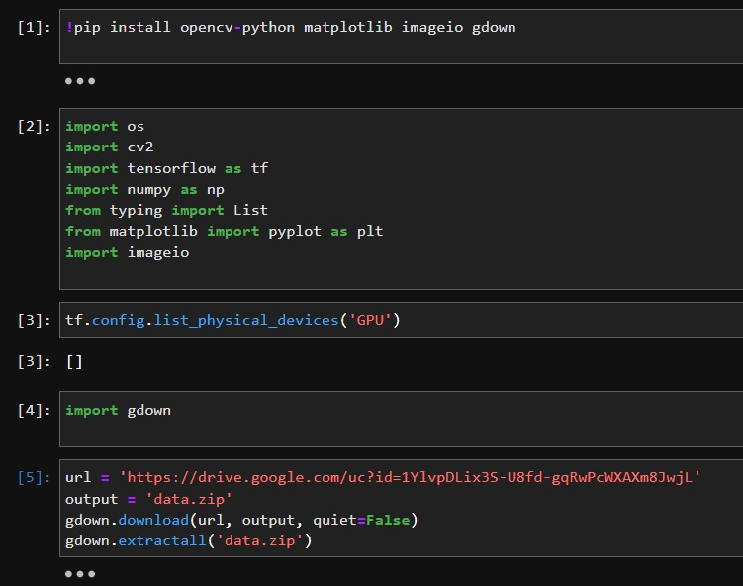
Methodology
IMPORTING DEPENDENCIES:

Slide 17
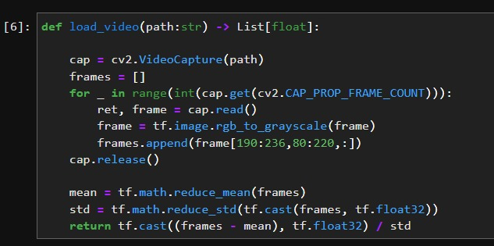
Build Data Loading Functions

Slide 18
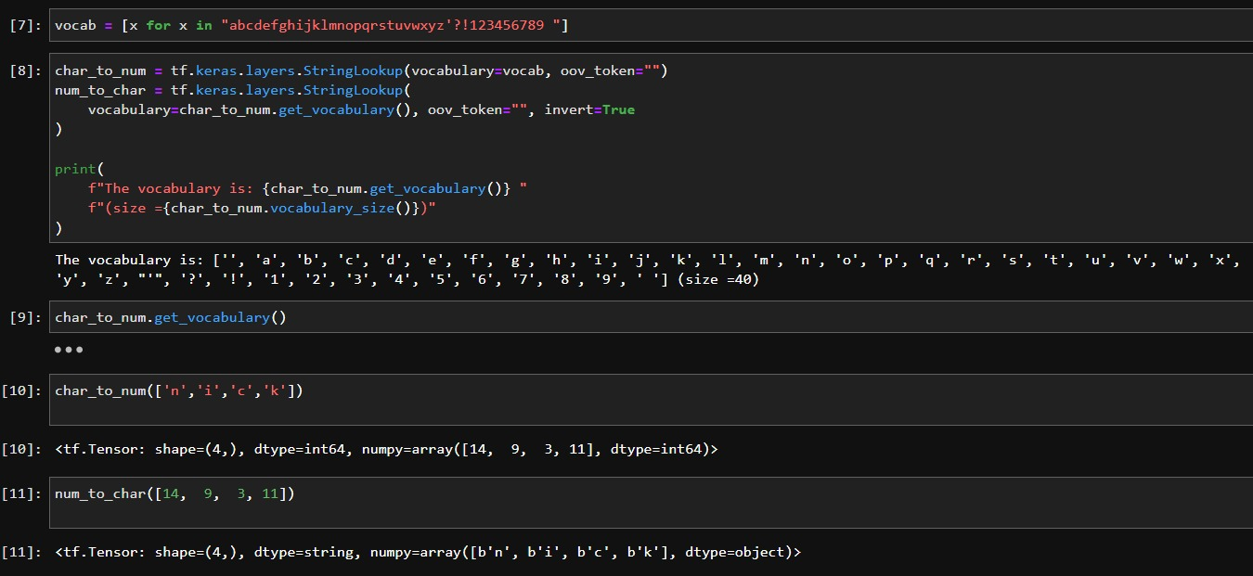
Build Data Loading Functions

Slide 19
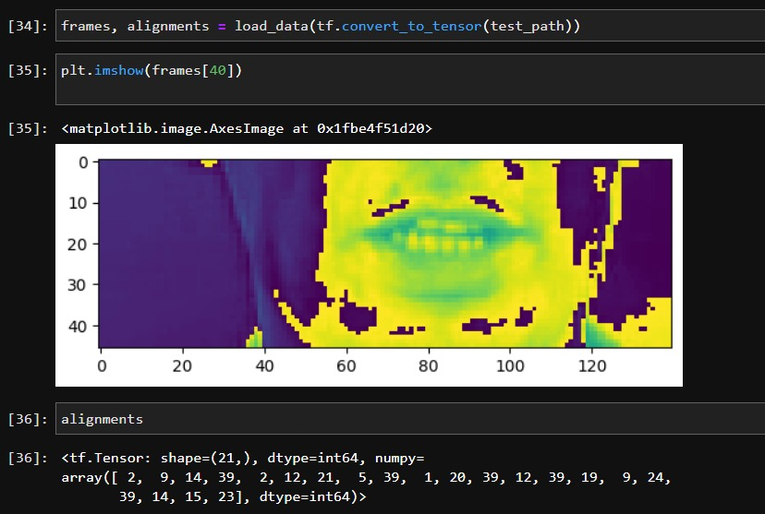
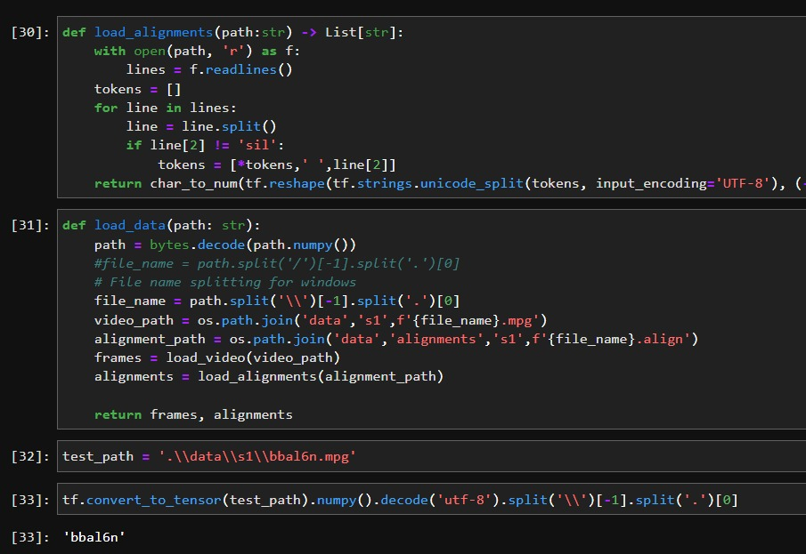
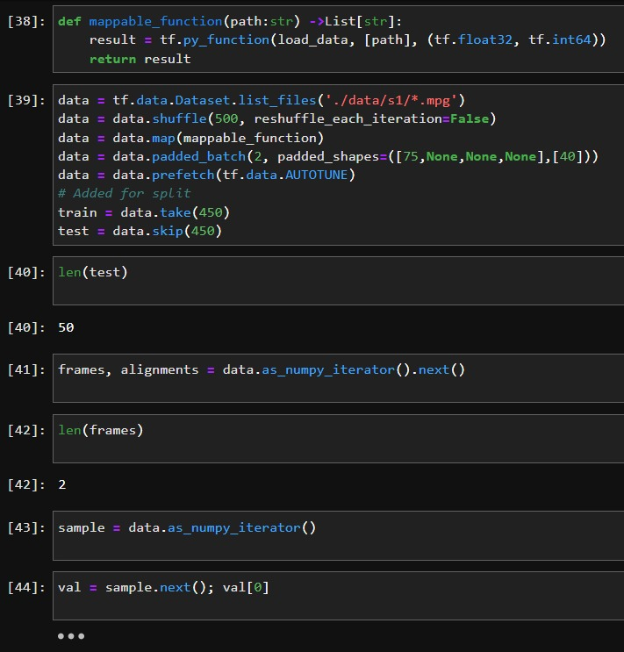
Build Data Loading Functions

Slide 20
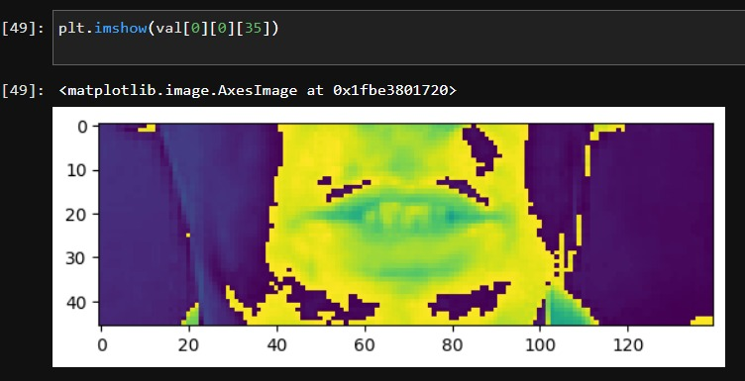
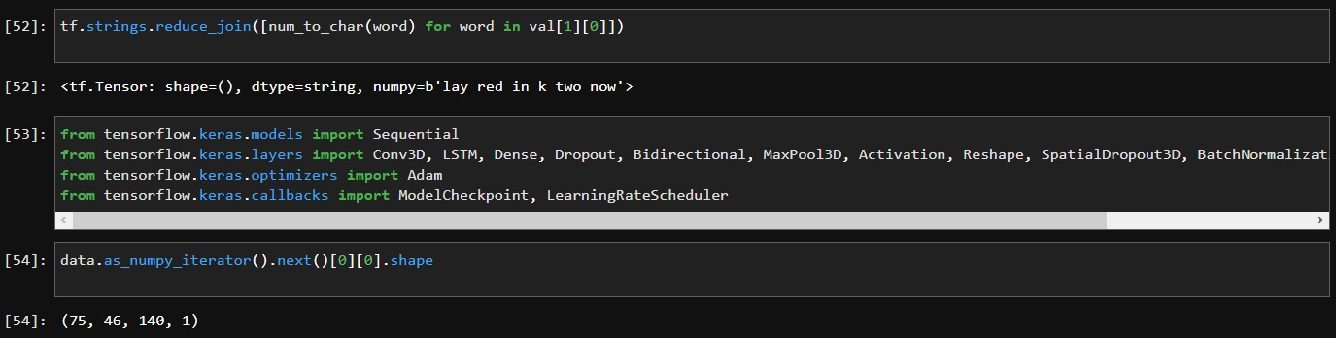
Create Data Pipeline

Slide 21
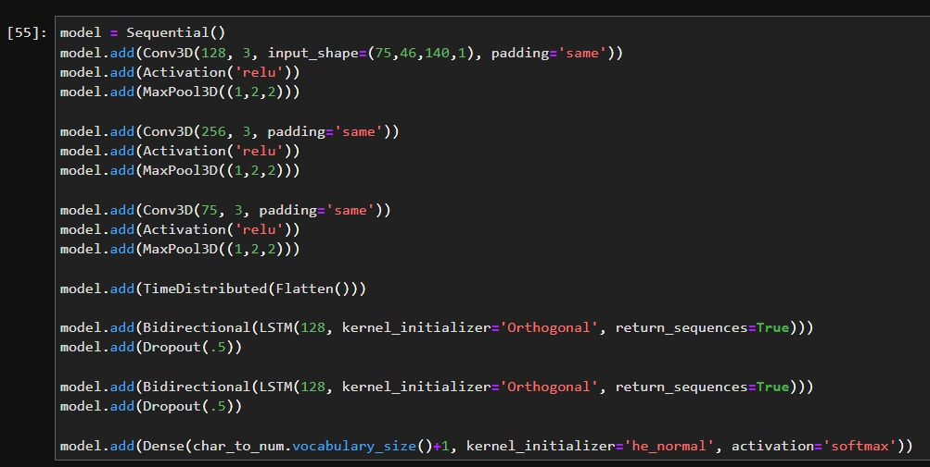
Design the Deep Neural Network

Slide 22
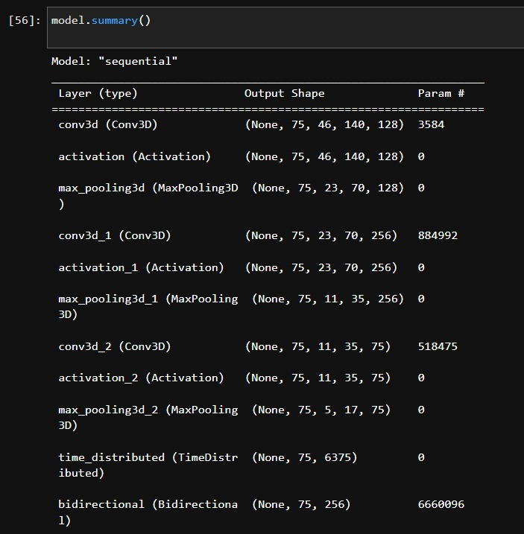
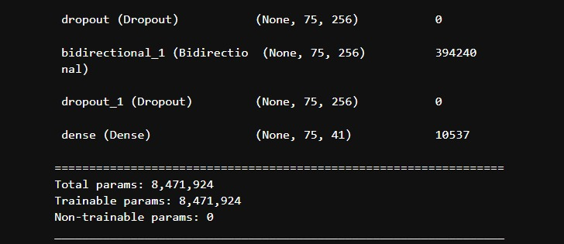
Design the Deep Neural Network

Slide 23
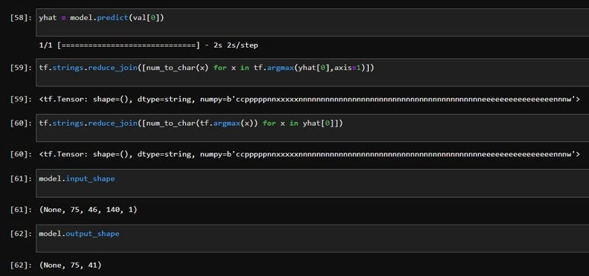
Design the Deep Neural Network

Slide 24
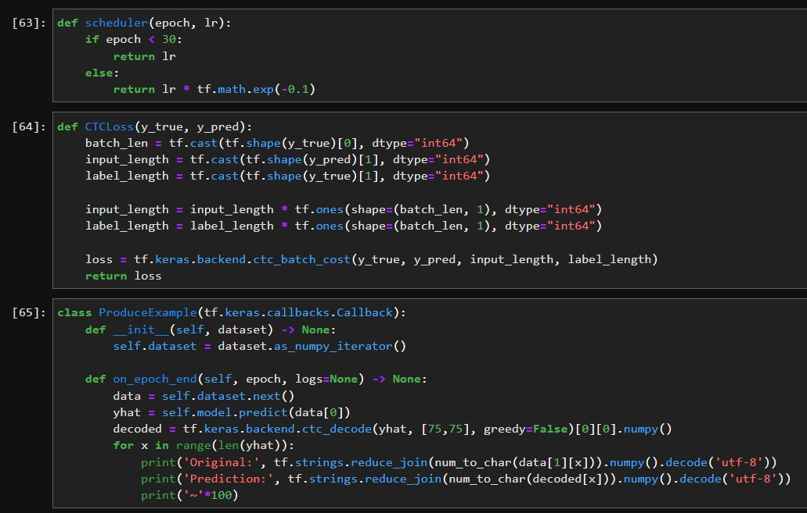
Setup Training Options and Train

Slide 25
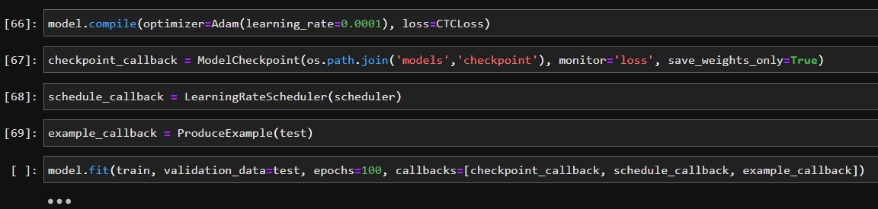
Setup Training Options and Train

Slide 26
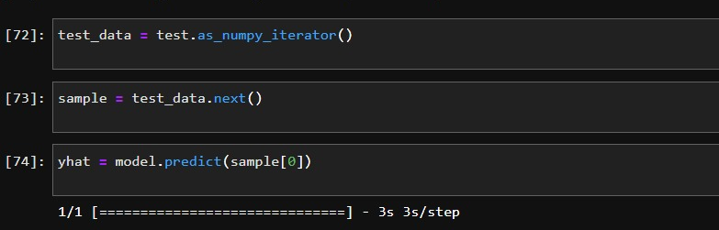
Make a Prediction

Slide 27
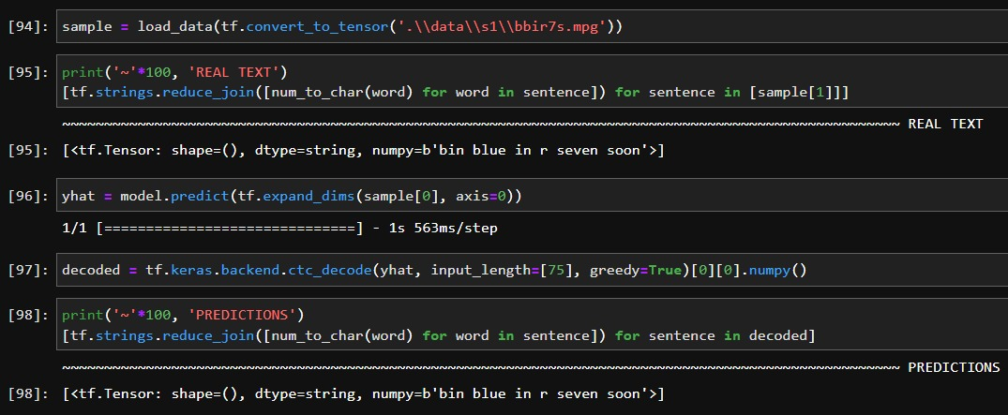
Make a Prediction

Slide 28
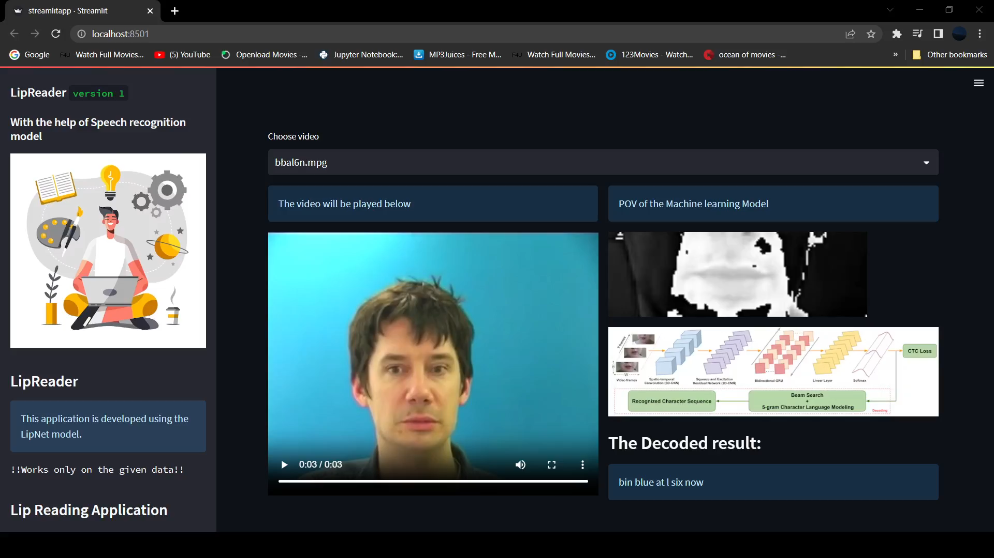
LipReader Web Application

Slide 29
Tools
Jupyter Notebook
>Tensorflow
>OpenCv
Visual Studio Code
>StreamLit

Slide 30
References
LIPNET: END-TO-END SENTENCE-LEVEL LIPREADING
Yannis M. Assael1,† , Brendan Shillingford1,† , Shimon Whiteson1 & Nando de Freitas1,2,3 Department of Computer Science, University of Oxford, Oxford, UK 1 Google DeepMind, London, UK 2 CIFAR, Canada 3

Slide 31
Thank You

